Slide 1
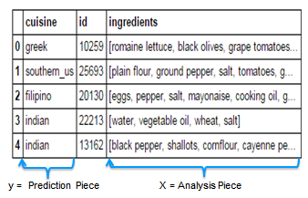
Data Science Presentation – What’s Cooking? - By Ameya Deolalkar
Introduction:
This project solves a Kaggle Competition: What's Cooking?. Project leverages Natural Language processing(NLP) techniques to predict a cuisine from a list of ingredients
Problem Statement: Use recipe ingredients to categorize the cuisine
The usual….:
Read .json data into pandas dataframe, define the features and dependent variable
[ { "id": 10259, "cuisine": "greek",
"ingredients": [ "romaine lettuce",
"black olives", "grape tomatoes",
"garlic", "pepper", "purple onion",
"seasoning", "garbanzo beans" ]

Slide 2
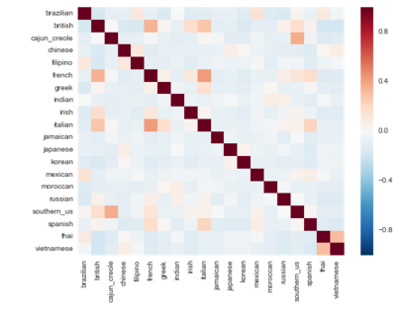
Implementations
Implementation 1:
The initial approach is to implement a Naive Bayes model on training and testing data tokenized using CountVectorizer
Evaluation metric: accuracy score, Result: Accuracy score 0.7198 (71.98%)

Slide 3
Implementations
Experiments to reduce error:
Use of stop_words – Stop top 10 repeating words
Result – Accuracy score: 0.7269
Use of max_df = 5000, max_features = 2100
Result – Accuracy score: 0.7272 (72.72%)
Implementation 2:
Feature Engineering – length of ingredient list
Logistic Regression – Has lower asymptotic error when number of features is large
TF-IDF Vectorizer – Frequency of an ingredient appearing in a cuisine is compared to its frequency across all cuisines

Slide 4
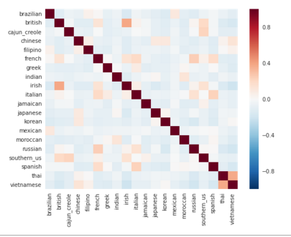
Implementations
Result – Accuracy score: 0.7331 (73%)

Slide 5
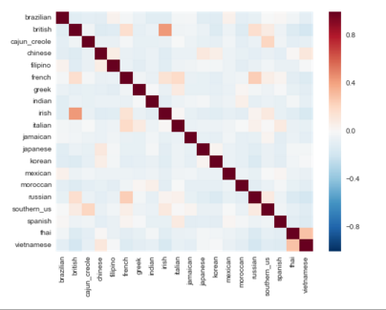
Implementations
Experiments to reduce error:
Find top 20 common ingredients between cuisines that are being confused the most
Set max_features to 700 which is approximately the mean of the frequency of occurrence of top 20 common ingredients in the cuisines selected
Iterate for different max_features to find the best value
Result: Accuracy Score - 0.7560 (75.60%)

Slide 6
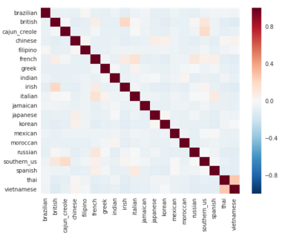
Implementations
Implementation 3:
One-vs-rest classifier: The strategy consists in fitting one classifier per class. For each classifier, the class is fitted against all the other classes.
Result: Accuracy Score – 0.7865 (78.65%)

Slide 7
Conclusion
Progress Timeline
Implementation 3
Implementation 2
Implementation 1
Kaggle score: 72.50
Position: 225
Kaggle score: 76.67
Position: 208
Kaggle score: 78.77
Position: 88

